Slide 1

Sprocket Central Pty Ltd
Data analytics approach
K.Maruthupandiyan

Slide 2
Agenda
Introduction
Data Exploration
Model Development
Interpretation

Slide 3

Introduction
Identify and Recommending High value Customers
Outline of this problem:
Spocket central is a one of the leading company specializes in high quality bike and accessories
The Marketing team is looking to boost sales
The Target 1000 newcustomer that will bring the highest value to the buisness

Slide 4

Approach For Data Analysis
Bike related purchases for the last 3 years based on Gender
Top Industries contributing the maximum profit and the bike related sales
Wealth segment by age category
Number of cars owned in each state
Customer classification

Slide 5
Data Exploration
Data Quality Assessment
Key Issue dealt with for the data quality issue:
Completeness
Consistency
Currency
Relevancy
Validity
wwwwwwwkkkkkkkkkksssssssssssssssskkkkkkkkkkkkkkkkkkkkkkkkkkkkkkwkwkkwkwkwkJjjjjjjjjjssdddddddddddddddf
Customer Demographic | DOB: Inaccurate Age:Missing | Job Title:Blanks Customer ID: Incomplete | Gender: Inconsistent | Deceased customer: Filtered out | Default column: Delete
Customer Address |  | CustomerID: Incomplete | State: Inconsistent
Transactions | Profit:Missing | CustomerID: Incomplete Online orders:Blanks Brands: Blanks |  |  | Cancelled status order:Filtered out | List price:Format product sold Date: Format
Accuracy

Slide 6
Bike related purchase over the last 3 years based on Gender:
Data Exploration
Data shows, on average females have made more bike related to purchases in the last 3 years compared to the Males.
On Average Females have had1% higher bike related purchase compared to men in the last 3 years

Slide 7
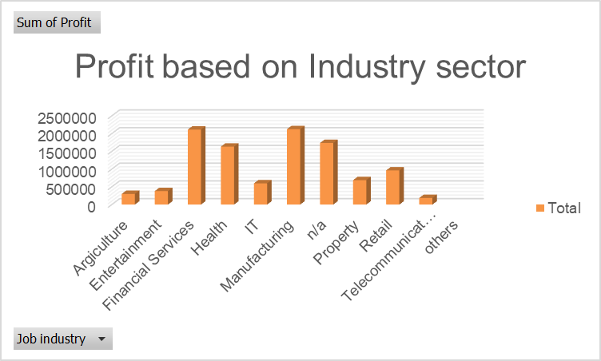
Top Industry contributing to the maxing property & bike Related purchases
Data Exploration
The Top 3 Industry sector Bringing in the Highest profit are: Financial services,Health& Manufacturing
These can be obvious as most of these Industry sectors are based within the city or on the outskirts of the city therefore consumers prefer bike for commuting
Most of the Industry sector have returned less than $1000000 profits

Slide 8
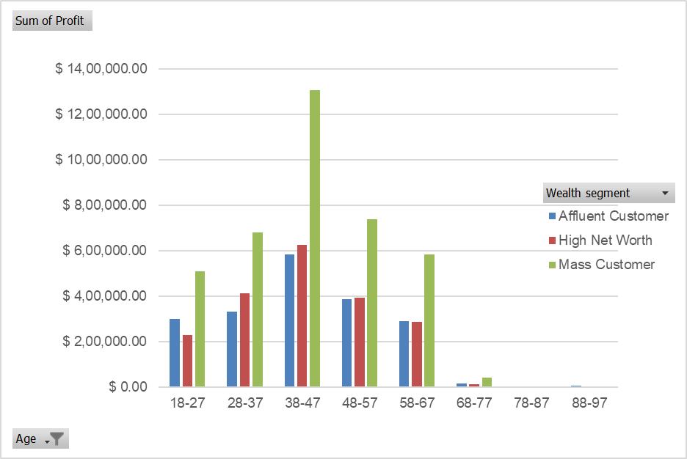
Profit of Wealth segment by Age sector:
Overall, the mass customer segmetation makes the highest profit across the different age clusters.
Age Cluster Profit
Mass customer aged between 38-47 likely to bring more profit for the company to other age clusters.
This is also indicates a trend to buying power, as the buying power increase over time till 47 and see’s a decline in buying power, thus leading to lower profits

Slide 9
Number of cars owned in Each state
NSW,VIC could be slighter potential opportunities for the company than the QLD
NSW, has the highest potential as the number of people that own car is almost equal to the people who don’t own cars which shows there is opportunity to find value customer there.

Slide 10
Model Development
Customer classification-Targeting High value Customers
These are the high value customers that should be targeted from the New list:
Most of the high value customers will be Female compared to the male.
Working in the Financial services , Health ,and Manufacturing Sector,
Aged between 38-47
Who are all currently Living in New south wales(NSW) and Victoria (VIC)

Slide 11
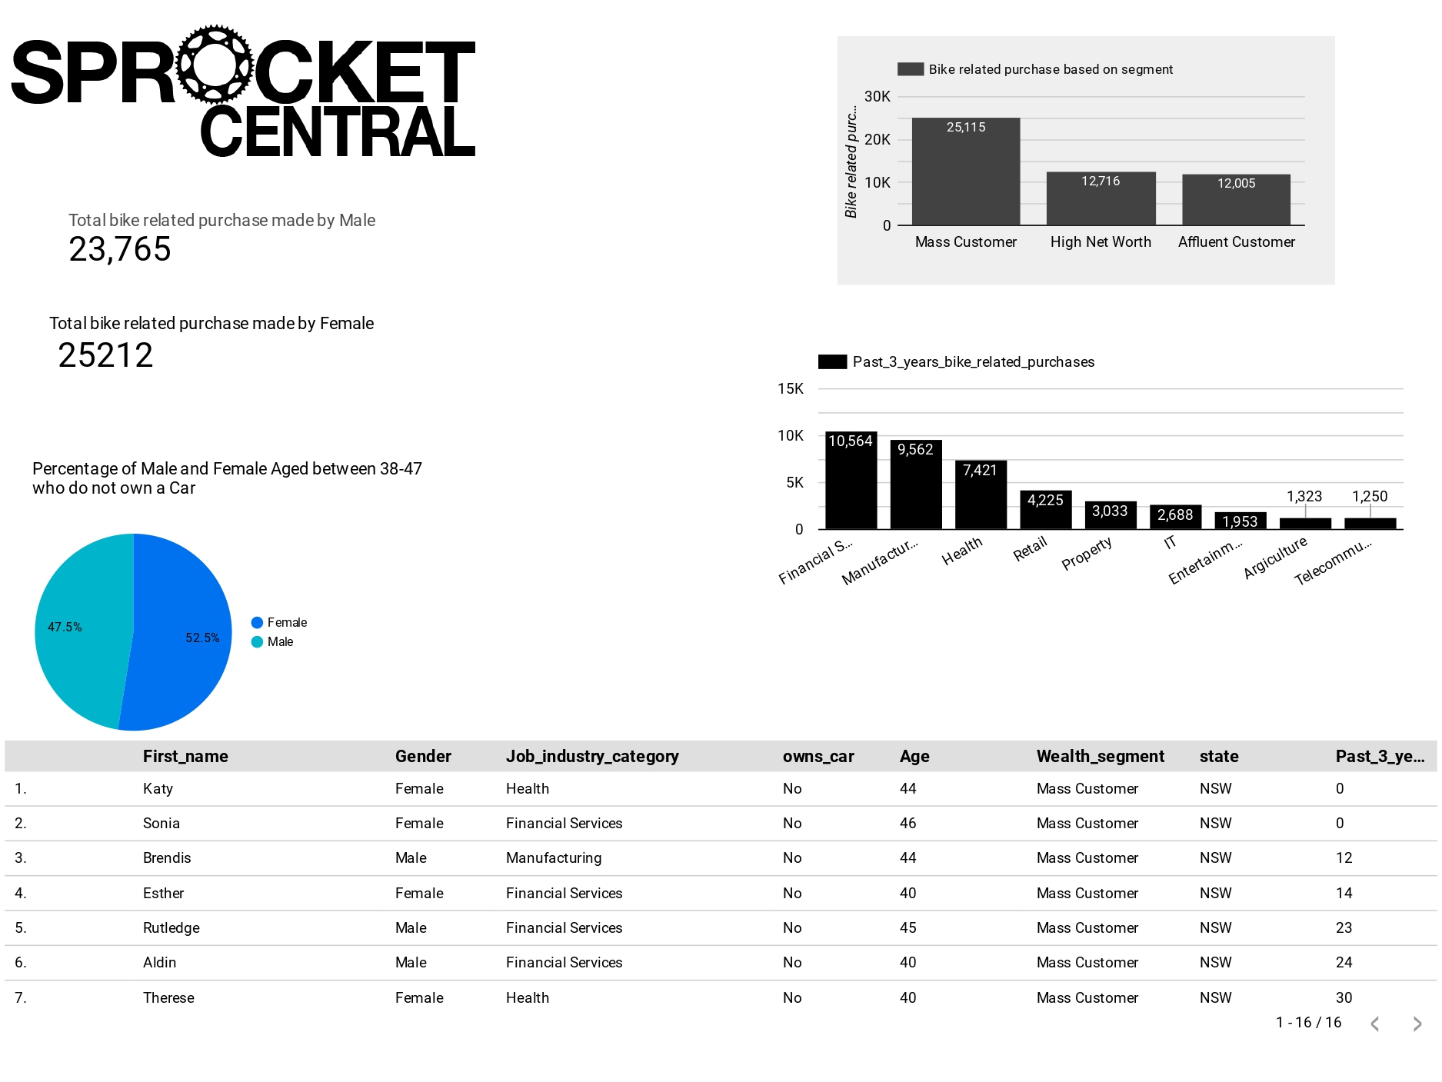
Interpretation
Here this is the Dashboard , which is having Higher Value Customer

Slide 12
Here this is my Google Dashboard work link , that which I had done my work
https://datastudio.google.com/s/rZ7BLwXkrLg

Slide 13
THANK YOU

